Slide 1
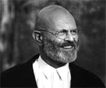
Jim Dine
Contemporary and Pop Artist
Born 1935 Cincinnati, Ohio

Slide 2
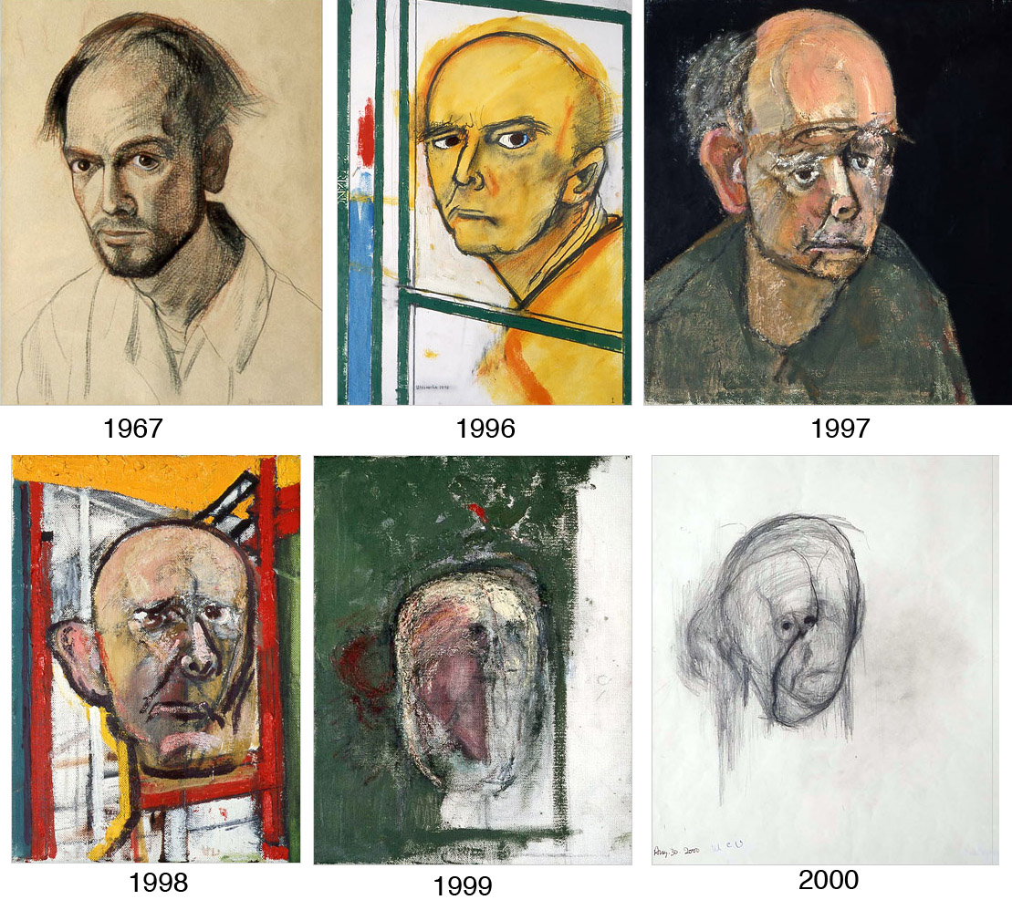

Slide 3
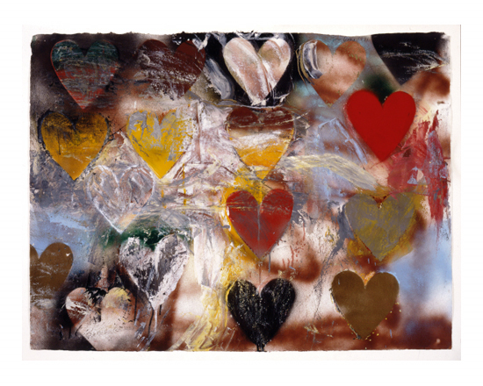
Jim Dine
Meadow Heart #1
1971

Slide 4
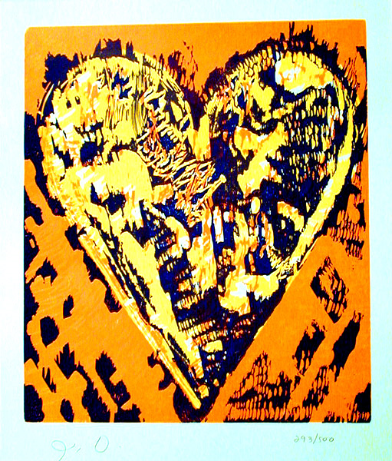
Woodcut Heart
Original color woodcut
1993

Slide 5
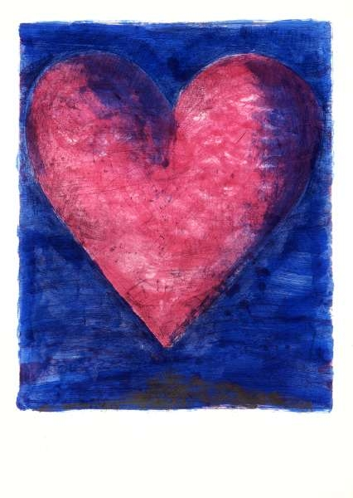
Jim Dine A Heart on the Rue De Grenelle
1981 Hand painted etching

Slide 6
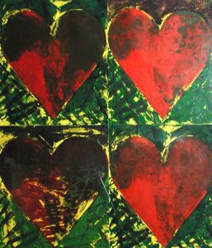
L.A. Eyeworks
1982
Etching

Slide 7
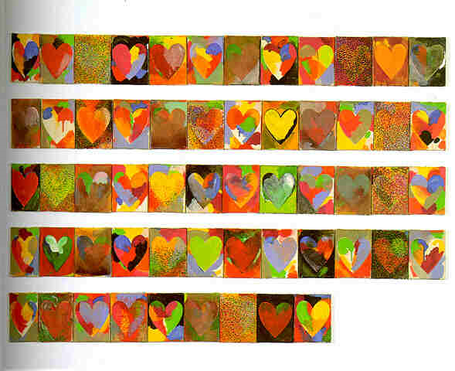
Jim Dine
Hearts
1969

Slide 8
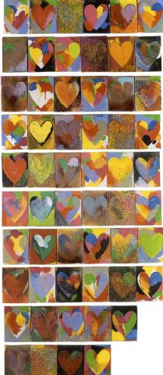
Jim Dine Hearts
1969

Slide 9
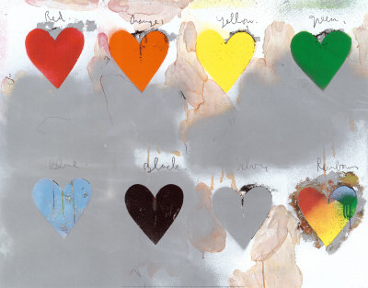

Slide 10
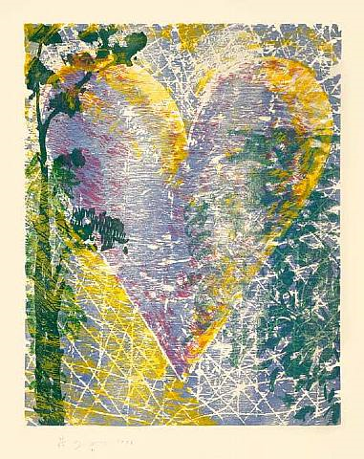
Jim Dine Lakeside 1998

Slide 11
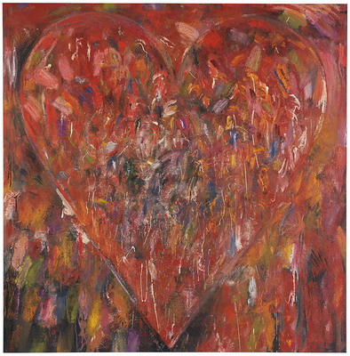
Jim Dine And the Lightening Bugs
2003 Oil, acrylic and charcoal on canvas

Slide 12
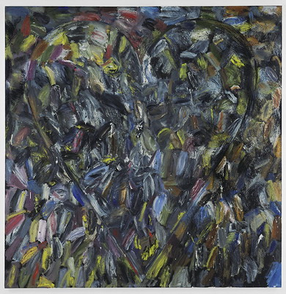
Jim Dine Delphinium Nights
2003 Oil and charcoal on canvas

Slide 13
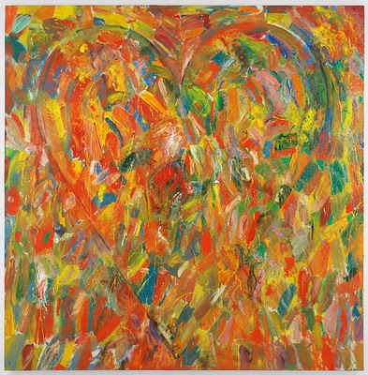
Jim Dine Mister Hollyhock
2003 Oil and charcoal on canvas

Slide 14
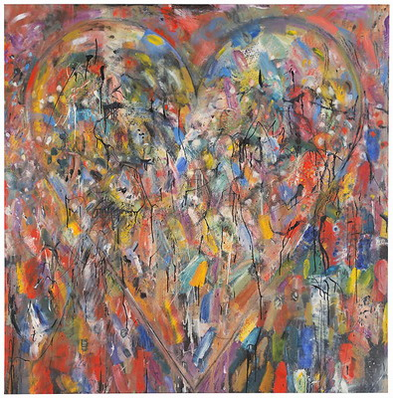
Jim Dine The Thrill of August
2003 Oil, acrylic and charcoal on canvas

Slide 15
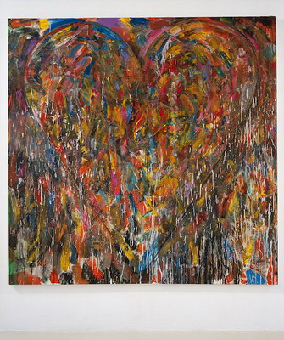
Jim Dine Mexico, When Times were Better
2003 Oil, acrylic and charcoal on canvas

Slide 16
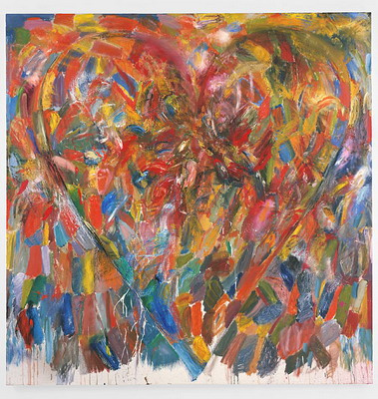
Jim Dine In Memory of Betty Prior
2003 Oil and charcoal on canvas

Slide 17
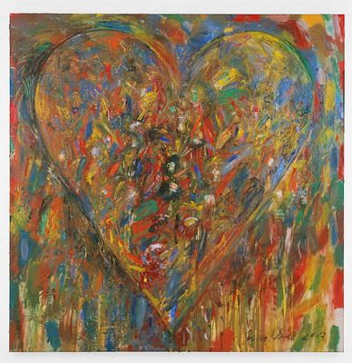
Jim Dine Great Maiden's Blush
2003 Oil and charcoal on canvas

Slide 18
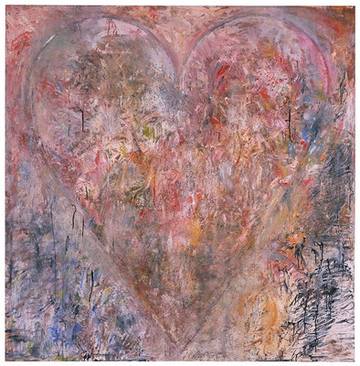
Jim Dine My Left Hand and Me
2003 Oil, acrylic and charcoal on canvas

Slide 19
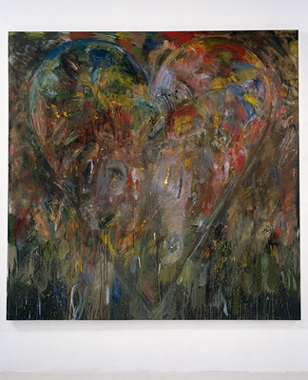
Jim Dine The Events Surrounding the May Uprising
2003
Oil, acrylic and charcoal on canvas

Slide 20
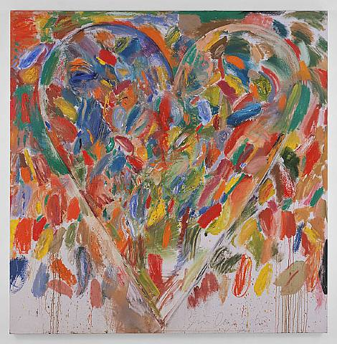

Slide 21
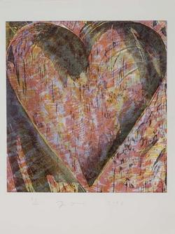

Slide 22
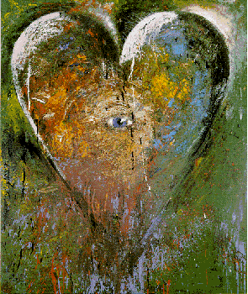

Slide 23
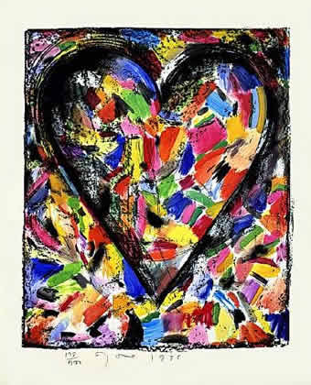

Slide 24
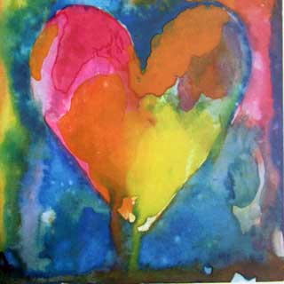

Slide 25
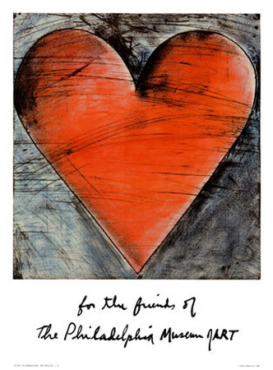

Slide 26
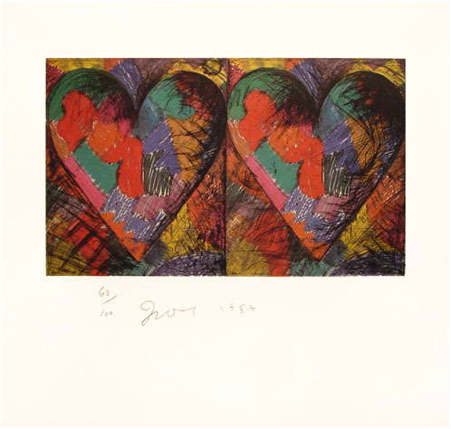

Slide 27
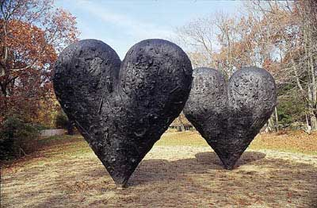
Two Big Black Hearts
1985
Bronze
12' x 12' x 33" each

